Slide 1
BlinkDB: Queries with Bounded Errors and Bounded Response Times on Very Large Data
Authors: Sameer Argarwal et al.
Presenters: Boyu Tian, Rui Liu, Haojun Ma
Some of the examples and slides are borrowed from conference slides in EuroSys 2013

Slide 2

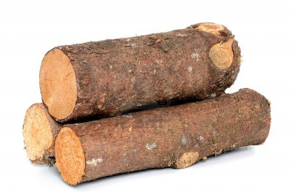

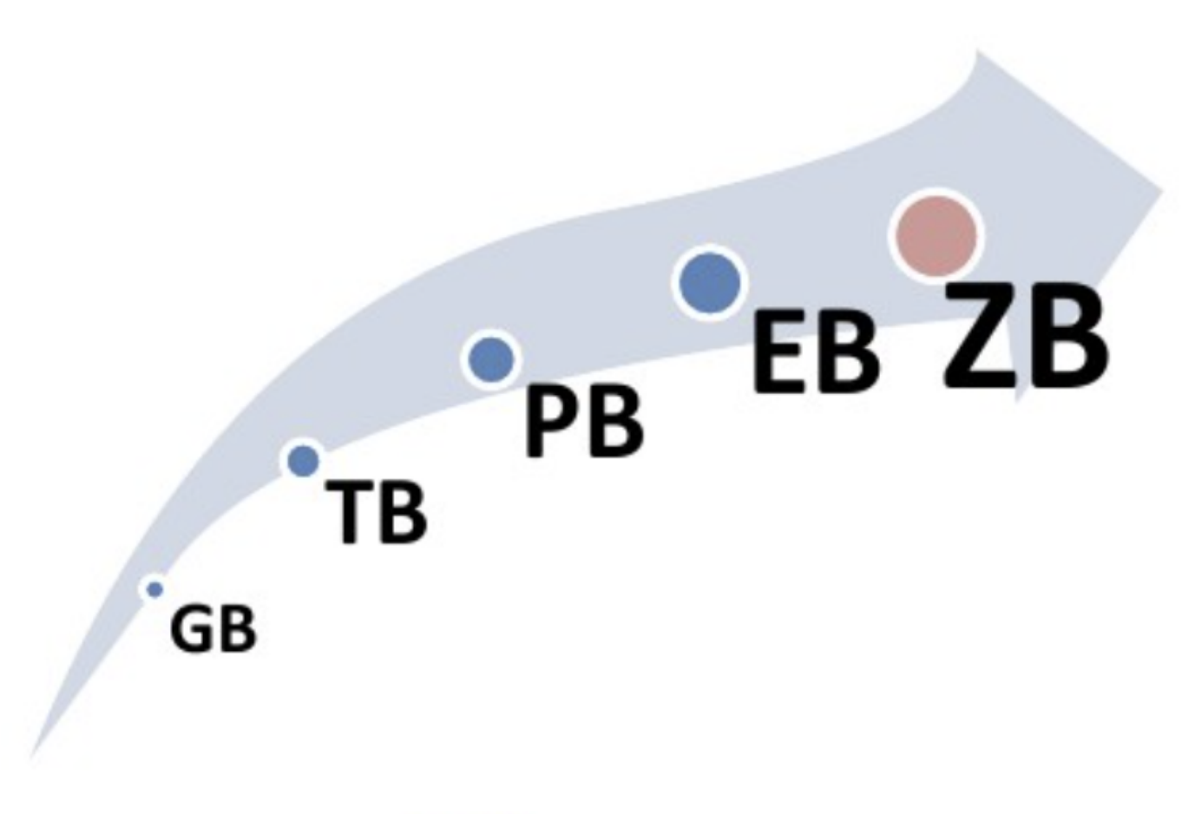
Big Data
Notes:
In these days, we have a lot of applications that produce a huge amount of data. For example, YouTube has a lot of videos in its datacenter. Google stores nearly the entire online world. Facebook and twitter have our social network. In their datacenters, analysis and process their data is pretty slow. Also, with our usage, the log of their service increases rapidly, which introduces more difficulty on this problem.

Slide 3


100 TB on 1000 machines
1~2 Hours
25~30 Minutes
1 Second
Hard Disk
Memory
Notes:
Assuming we have …… Now, we want to run a query. If we put them on hard disk, ……. To improve the performance, we spend a lot of money and bought a lot of memory and put these data in memory(just like what we did in spark). Now, the io is much faster and we can improve. To achieve interactive answer.

Slide 4

Target Workload
1. Real-time latency is valued over perfect accuracy: ≤10s for interactive experience
2. Exploration is ad-hoc
3. Columns queried together (i.e., Templates) are stable over time
4. User defined funcIons (UDF) must be supported: 43.6% of Conviva’s queries
5. Data is high-dimensional & skewed: 100+ columns
“On a good day, I can run up to 6 queries in Hive.”
- Anonymous Data Scientist at
Notes:
Real-time latency is valued perfect accuracy
Adhoc: Queries are not known in advance!
Popular column sets are stable!
UDFs are common
Curse of dimensionality
Skewed data
Accuracy Guarantees are needed

Slide 5
Target Workload
1. Real-time latency is valued over perfect accuracy: ≤10s for interactive experience
2. Exploration is ad-hoc
3. Columns queried together (i.e., Templates) are stable over time (Called as Query Column Set)
4. User defined functions (UDF) must be supported: 43.6% of Conviva’s queries
5. Data is high-dimensional & skewed: 100+ columns
“On a good day, I can run up to 6 queries in Hive.”
- Anonymous Data Scientist at
90% Queries ≈ 20% Templates (Facebook)
Notes:
First, latency.
The exploration is ad-hoc.

Slide 6
Overview
Problem: Need to compute aggregate statistics over massive sets of data
Goal: Support interactive ad-hoc analytical queries over these large datasets

Slide 7
Interface
SELECT COUNT(*)
FROM Table
WHERE (city=‘NY’)
LIMIT 1s
234 ± 15
Notes:
BlinkDB tries to solve this problem by maintaining multi-granular samples on input data.
This in turn enables us to answer queries within specific time intervals or error bounds.
For eg. in the first example, a query can be augmented with a one second time bound, and BlinkDBwill try to return the most accurate answer within the time bound.
Similarly, a query can be augmented with a specific error bound and a confidence interval in which the system will return the fastest possible answer within this bound.
We believe that using BlinkDB, a user will be able to rapidly compute fairly sophisticated statistics on large data

Slide 8
Interface
SELECT COUNT(*)
FROM Table
WHERE (city=‘NY’)
LIMIT 2s
234 ± 15
234 ± 15
239 ± 4
SELECT COUNT(*)
FROM Table
WHERE (city=‘NY’)
ERROR 10% CONFIDENCE 95.0%
239 ± 23
Notes:
BlinkDB tries to solve this problem by maintaining multi-granular samples on input data.
This in turn enables us to answer queries within specific time intervals or error bounds.
For eg. in the first example, a query can be augmented with a one second time bound, and BlinkDBwill try to return the most accurate answer within the time bound.
Similarly, a query can be augmented with a specific error bound and a confidence interval in which the system will return the fastest possible answer within this bound.
We believe that using BlinkDB, a user will be able to rapidly compute fairly sophisticated statistics on large data

Slide 9
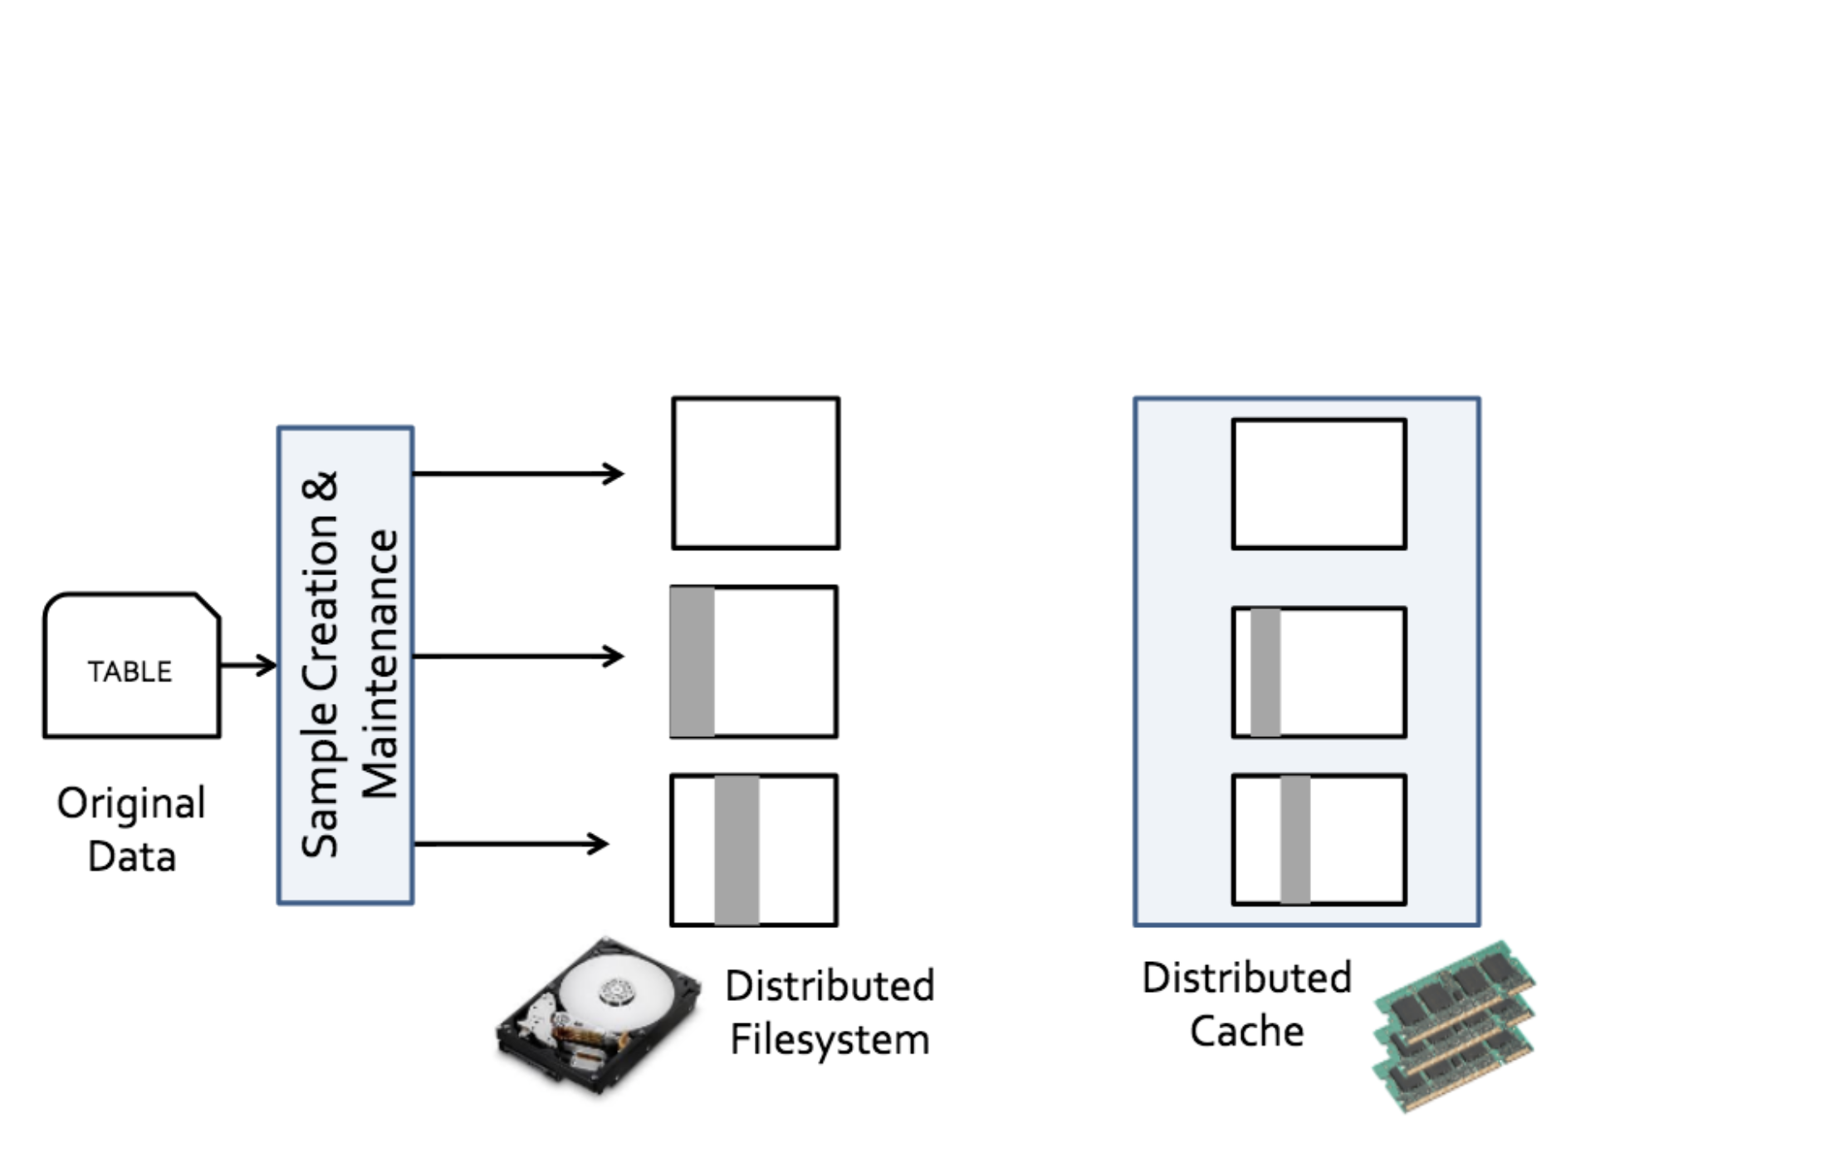
BlinkDB Architecture
Notes:
To implement this functionality, BlinkDB uses an off-line module to build a set of samples for the original tables. These includes an uniform sample
Reminder: Hive is a very popular data warehouse, which is an open-source implementation of SQL that uses Hadoop

Slide 10
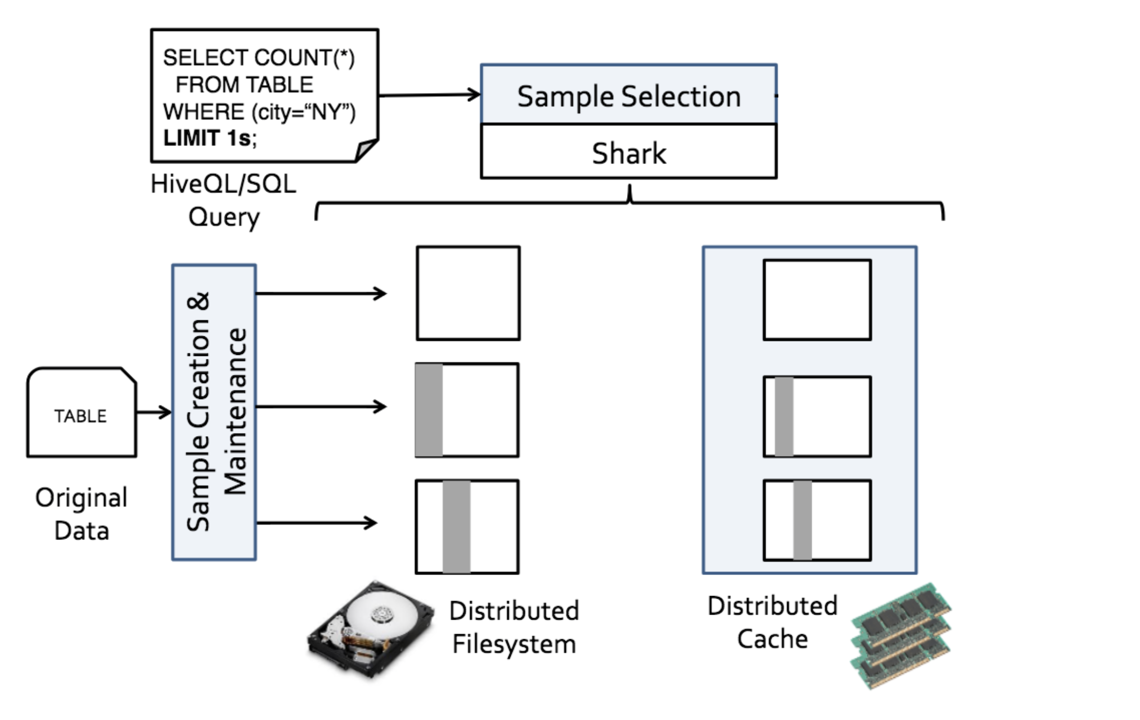
BlinkDB Architecture
Notes:
To implement this functionality, BlinkDB uses an off-line module to build a set of samples for the original tables. These includes an uniform sample
Reminder: Hive is a very popular data warehouse, which is an open-source implementation of SQL that uses Hadoop

Slide 11
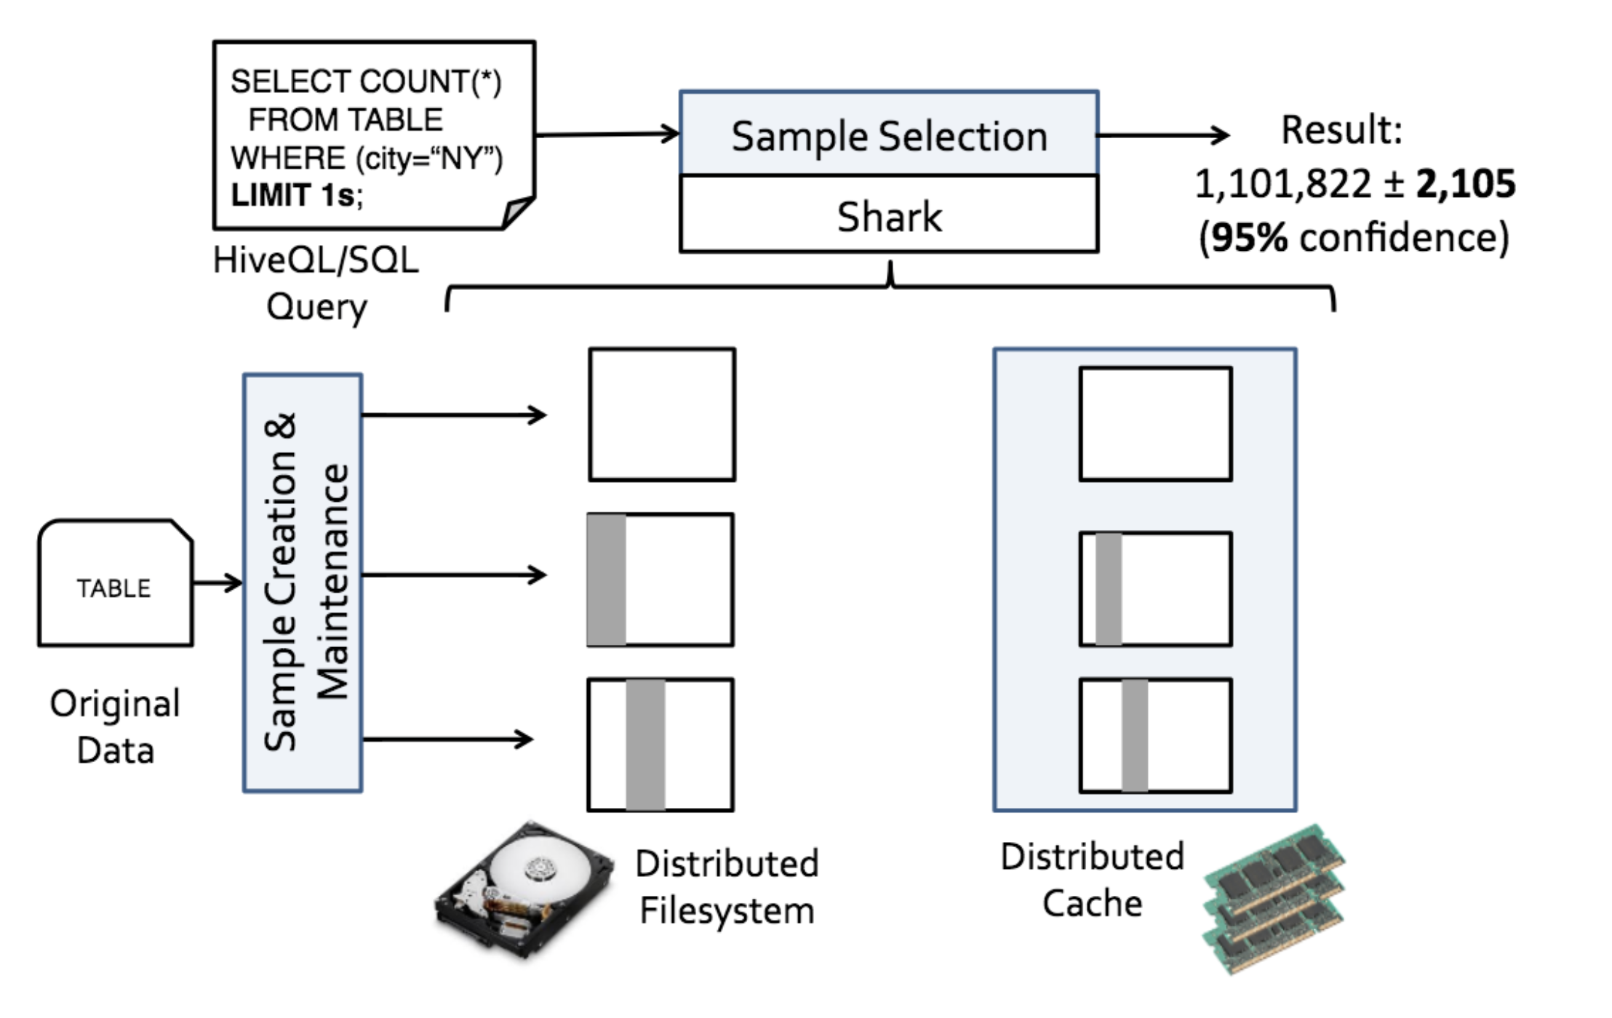
BlinkDB Architecture
Notes:
An offline sampling module that creates and maintains samples over time.
A run-time sample selection module that creates an Error-Latency Profile for queries.

Slide 12
Two Challenges
How to choose the offline samples;
How to select the sample to use at run-time.

Slide 13
Offline Sampling
Stratified sampling
Sample size
Stratification attributes
Notes:
First, let me talk about the offline part of the system. In the offline part, BlinkDB build samples of the table in order to deal with the online queries. The sampling method it uses is called stratified samlpe.
I will talk about what is stratified sampling, how the sample size is chosen in stratified sample used by BlinkDB, and how the stratification attributes are chosen.

Slide 14
Uniform Sampling
10⁶ from Ann Arbor
10³ from Lansing
10³ rows as sample
select avg(salary)
from T
where city=“Lansing”
ID | City | Salary
1 | Ann Arbor | 3,400
2 | Ann Arbor | 2,300
3 | Lansing | 12,500
4 | Ann Arbor | 3,700
5 | Lansing | 2,500
… | … | …
Notes:
When we learn sampling in high school, we are taught to draw a uniform sample. For example, I have a table here that contains a million people from aa and …
The small population problem.

Slide 15
Stratified Sampling
10⁶ from Ann Arbor
10³ from Lansing
500 rows from Ann Arbor
500 rows from Lansing
ID | City | Salary
1 | Ann Arbor | 3,400
2 | Ann Arbor | 2,300
3 | Lansing | 12,500
4 | Ann Arbor | 3,700
5 | Lansing | 2,500
… | … | …
Notes:
Stratified sampling is what we use to deal with this problem. Stratified sampling means that we first divide the table into several groups called strata, and then we sample from each stratum individually.

Slide 16
Stratified Sampling
select avg(salary)
from T
where city=“Lansing”
and nationality=“Indian”
Stratify on (city, nationality)
ID | City | Nationality | Salary
1 | Ann Arbor | American | 3,400
2 | Ann Arbor | Chinese | 2,300
3 | Lansing | Indian | 12,500
4 | Ann Arbor | American | 3,700
5 | Lansing | Canadian | 2,500
… | … |  | …
Notes:
In stratified sampling, the stratification attribute may not be a single attribute. It can also be the combination of several different attributes. For example, if we deal with this query, which involves city and nationality, we can build a sample stratified on the pair (city, nationality)

Slide 17
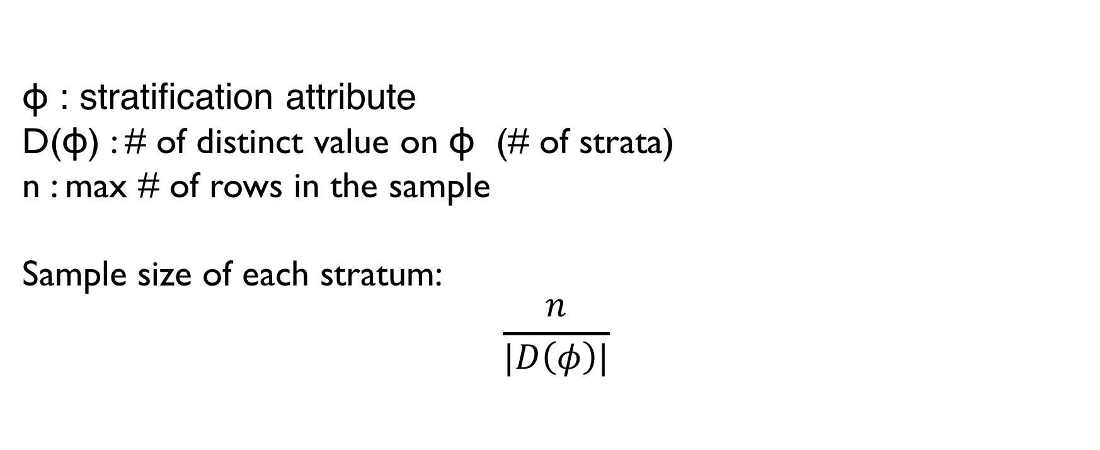
Sample Size
ɸ : stratification attribute
D(ɸ) : # of distinct value on ɸ (# of strata)
n : max # of rows in the sample
Sample size of each stratum:
$$\frac{n}{|D\left(φ\right)|}$$

Slide 18
Stratified Sampling
10⁶ from Ann Arbor
10³ from Lansing
500 rows from Ann Arbor
500 rows from Lansing
ID | City | Salary
1 | Ann Arbor | 3,400
2 | Ann Arbor | 2,300
3 | Lansing | 12,500
4 | Ann Arbor | 3,700
5 | Lansing | 2,500
… | … | …
Notes:
For instance in this example, we divide our 1000 rows in the sample evenly for Ann Arbor and Lasing.

Slide 19
Stratified Sampling
10⁶ from Ann Arbor
10³ from Lansing
10⁴ from Ypsilanti
333 rows from Ann Arbor
333 rows from Lansing
333 rows from Ypsilanti
ID | City | Salary
1 | Ann Arbor | 3,400
2 | Ypsilanti | 2,300
3 | Lansing | 12,500
4 | Ann Arbor | 3,700
5 | Lansing | 2,500
… | … | …
Notes:
However, if we also have ypsilanti here, we take 333 rows from each of the three cities

Slide 20
Stratification Attributes
Queries can be based on : city, (city, nationality), …
n columns in the table
2^{n} possible combination (QCS)
n goes up to 100
Which stratification attributes do we use?
Notes:
Now we talk about how we choose the stratification attributes. When we deal with queries, the queries can be based on a combination of different attributes, for example …

Slide 21
Stratification Attributes
Sparsity of the data
Stratification matters when there are small groups
ID | City | Salary
1 | Ann Arbor | 3,400
2 | Ypsilanti | 2,300
3 | Lansing | 12,500
4 | Ann Arbor | 3,700
5 | Lansing | 2,500
… | … | …
10⁶ from Ann Arbor
10⁶ from Lansing
10⁶ from Ypsilanti

Slide 22
Stratification Attributes
Sparsity of the data
Stratification matters when there are small groups
Workload
Each QCS has a probability p
city : 0.3 probability
(city, nationality) : 0.001 probability

Slide 23
Stratification Attributes
Sparsity of the data
Stratification matters when there are small groups
Workload
Each QCS has a probability p
Storage cost
Main constraint preventing us from building too many samples

Slide 24
Runtime
Which sample to use
How many rows to read from the sample
Notes:
Next, I’m gonna talk about the online part of the system. In order to estimate a query online and satisfy the error or time constraints specified by the user, BlinkDB does the following two things.
First, we need to decide which sample is used to estimate the query.
Second, how many rows should we read from the sample?

Slide 25
Selecting Sample
city, (city, nationality), (city, nationality, job, age)
(city, nationality)
(city, blood-type)
select sample with high selectivity

Slide 26
Number of Rows to Read
Error constraints: Error Profiler
Response time constraints: Latency Profiler

Slide 27
Error Profiler
Calculate # of matching rows needed
Estimate selectivity
Calculate # of rows to read from the sample

Slide 28
Latency Profiler
Run a few smaller samples
assuming latency scales linearly with input size

Slide 29
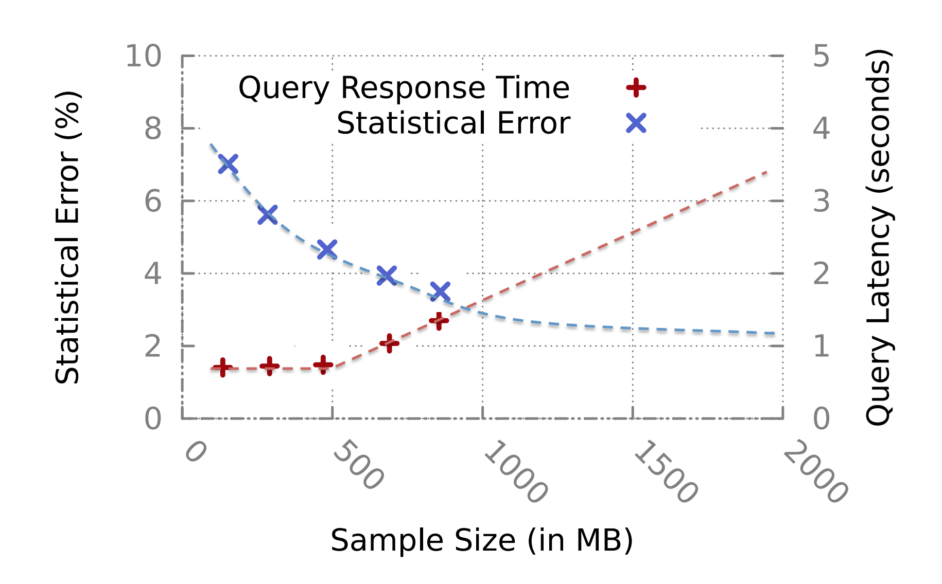
Example

Slide 30
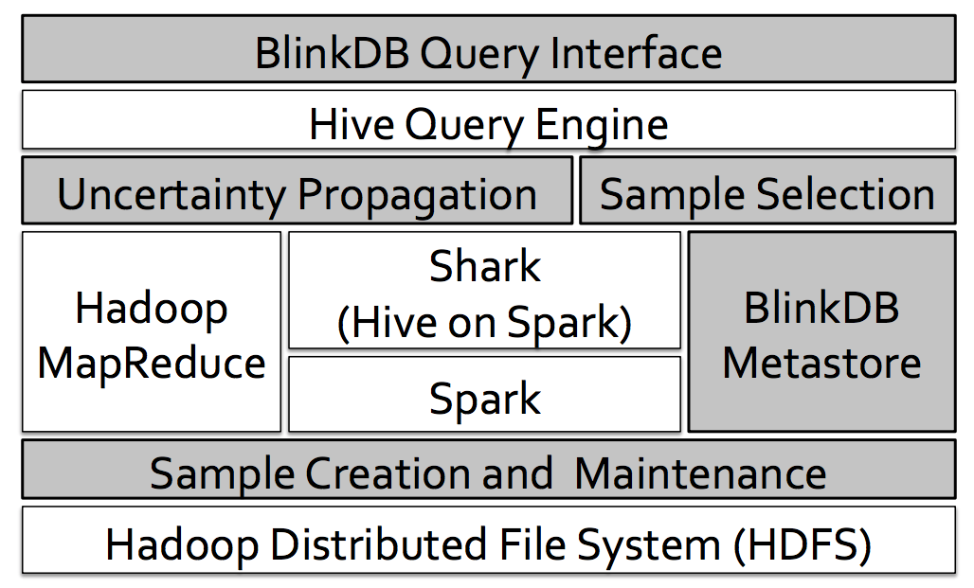
Implementation
Fault Tolerance?
Scalability?
Notes:
Now I am going to talk about the implementation of BlinkDB. Essentially, BlinkDB is built on top of Hive or Hive on Spark. The modules in grey background are new modules introduced by BlinkDB. It has a BlinkDB query interface which can parse queries with response time and error bounds constraints. For every query, the sample selection module select a sample on which query answer is computed. Uncerntainty Propogation module provides the error bars and confidence intervals associated to query result. BlinkDB Metastore saves the metadata of BlinkDB, like indices to sample locations. Sample Creation and Maintenance module is used to create and maintain sample set. Because BlinkDB is built on top of Hive or Spark, the fault tolerance and scalabiliy of BlinkDB are supported by Hive or Spark.

Slide 31
Evaluation Setting
Dataset
Conviva: 17 TB
TPC-H: 1 TB
Cluster
# of nodes: 100
Distributed Disk: 75 TB
Distributed RAM: 6 TB
Notes:
To evaluate the performance of BlinkDB, they use two datasets. One dataset is from Conviva Inc. It has 17 TB in size. The other dataset is TPC-H benchmark. It is 1 TB in size. The cluster they used consists of 100 nodes. It has 78 TB distributed disk and 6 Tb distributed RAM.

Slide 32
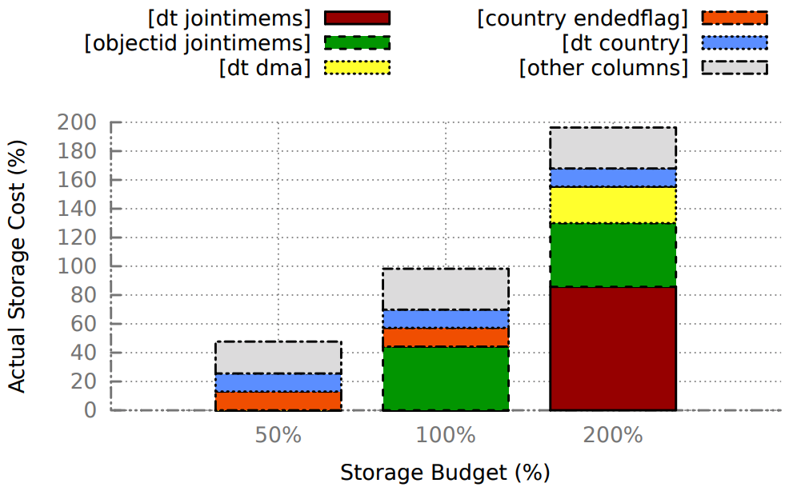
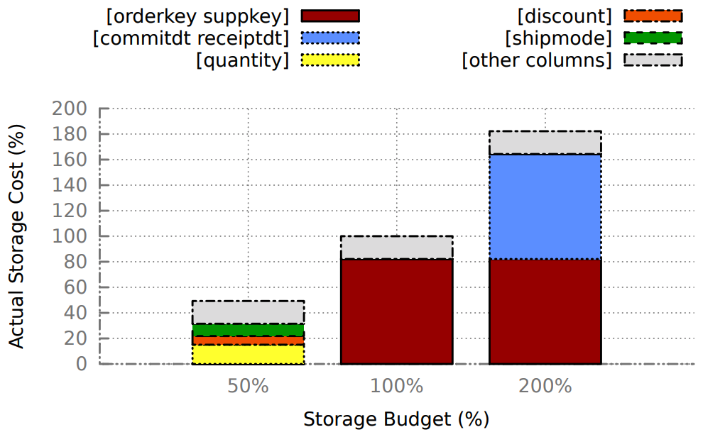
Size of Stratified Samples
(a) Conviva
(b) TPC-H
Notes:
First, they check the relative size of the stratified samples created with different storage budget. The left figure is on Conviva data and the right figure is on TPC-H data. The x-axis is the percentage of storage budget compared to the size of original data. If you guys remember, the size of Conviva is 17 TB and size of TPC-H is 1 TB. The y-axis is the percentage of actual storage cost for the stratified samples. It is obvious that different stratified samples will be created when imposing different storage budgets. And BlinkDB tends to create larger sample when possible. This larger sample comes from query column set that has large number of small groups.

Slide 33
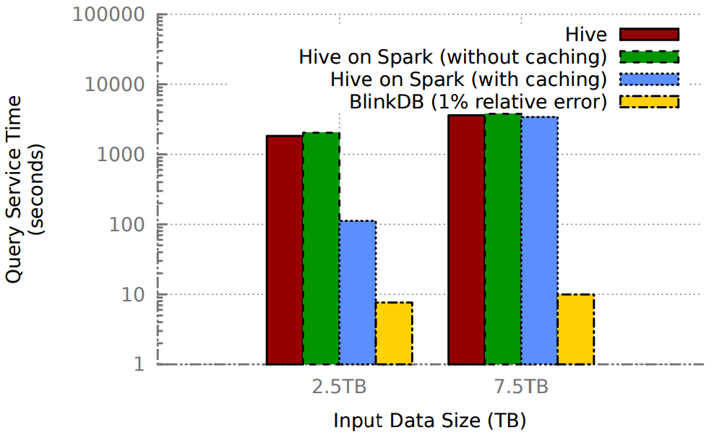
Comparison of Response Time
Notes:
They then compare BlinkDB against Hive and Hive on Spark with or without caching in terms of response time. Hive on Spark use spark the underlying computation framework, so they can choose to cache the intermediate RDD in memory. Clearly, BlinkDB has much smaller response time than other frameworks on both large input data and small input data. It is worth noting that Hive on Spark with caching has low response time on small data while it has large response time on large data. It is because large data can’t fit into the memory. The whole distributed memory is 6 TB.

Slide 34
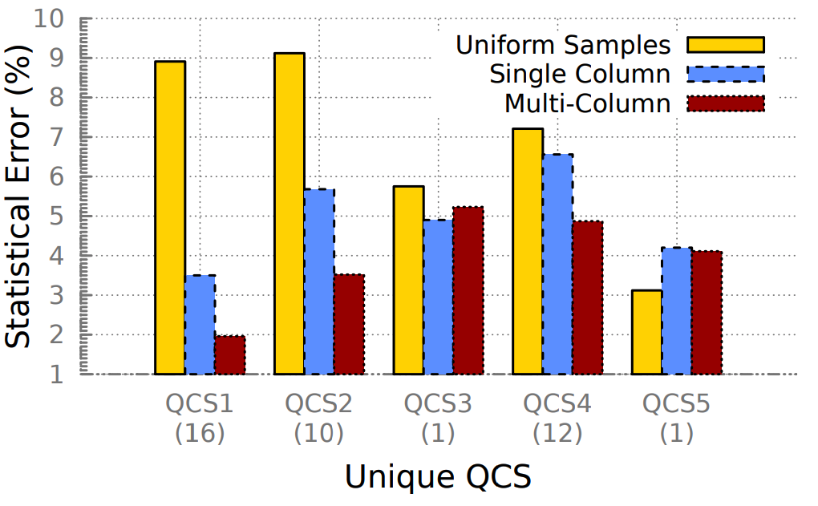
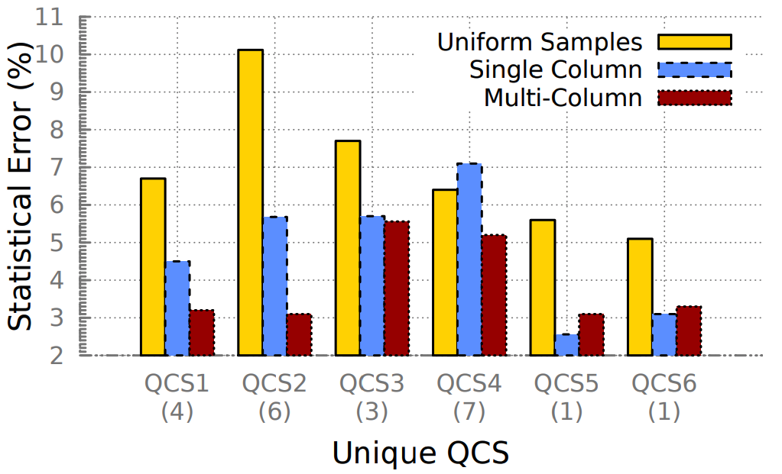
Comparison of Statistical Error
(a) Conviva
(b) TPC-H
Notes:
Next, to illustrate the advantages of using multi-dimensional stratified samples, they compare the statistical error for running queries for 10 sec over three sets of samples that are created by three different sampling strategies. Single-column sampling is created using the same sample creation module in BlinkDB with the restriction that sample is stratified on exactly 1 column. For multi-column stratified samples, BlinkDB has samples stratified on QCS1 and QCS2 on Conviva data, and on QCS1, QCS2 and QCS4 on TPC-H data. For queries on these 5 QCS, we can see that using mutl-column sampling produce smaller error than using other two sampling strategy. However, Multi-column set won’t necessarily give smaller error on other QCS. It implies that BlinkDB attemps to improve expected error among different, but not the error for every query.

Slide 35
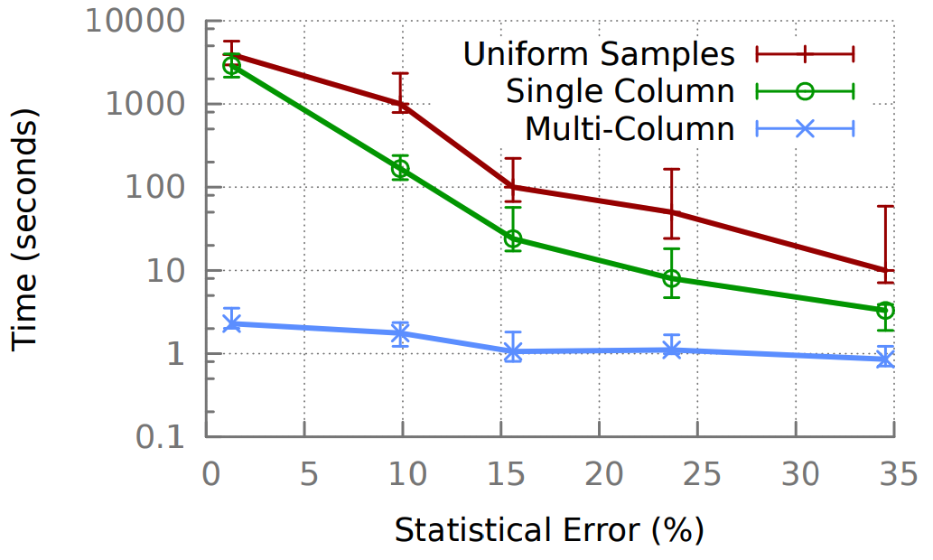
Error Convergence
Notes:
Next, they compare multi-colmun stratified sampling against the other two in terms of response latency on different error bound constraints. Clearly, to achieve certain error, BlinkDB on multiple-column samples has the lower latency than other two, especially when contrainted error is small.

Slide 36
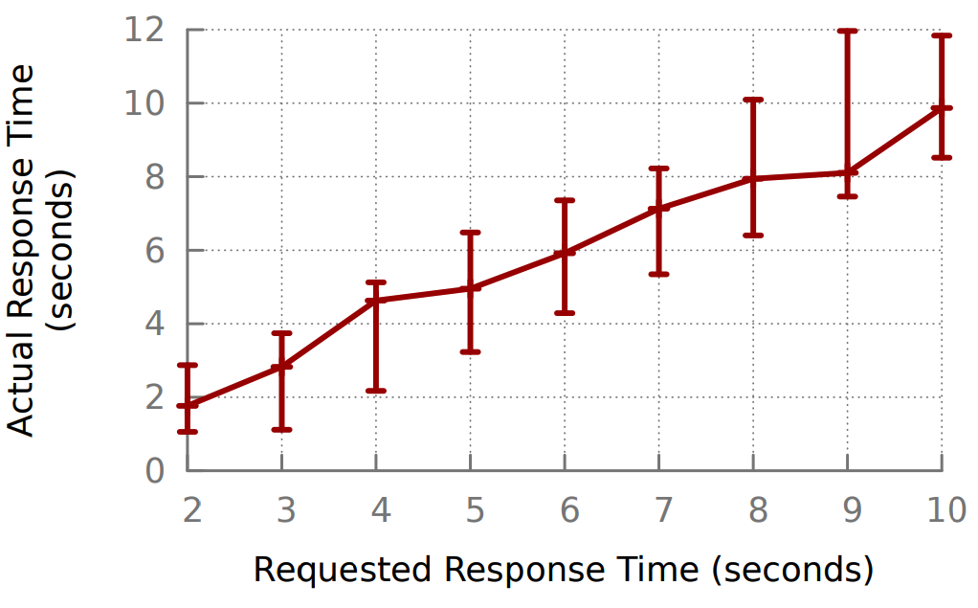
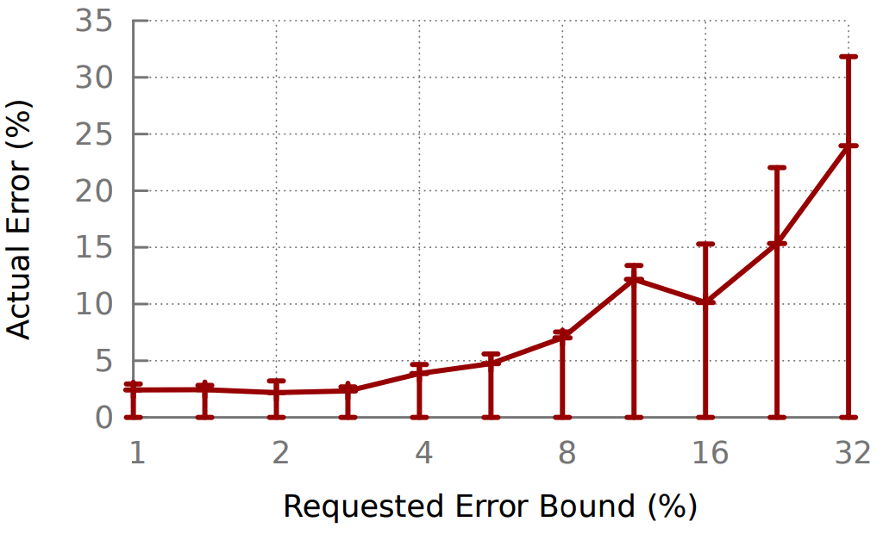
Actual vs. Requested Time and Error
(a) Response Time Bounds
(b) Relative Error Bounds
Notes:
In this slide, they evaluate BlinkDB’s effectiveness at meeting different time and error bounds requested by the user. The x-axis is the requested response time or the requested error bound, and y-axis is the actucal responset time or the error when executing corresponding queries. Clearly, the plotted curves are either close to or below the diagonal lines. It implies that BlinkDB is able to meet the requested time and error bound.

Slide 37
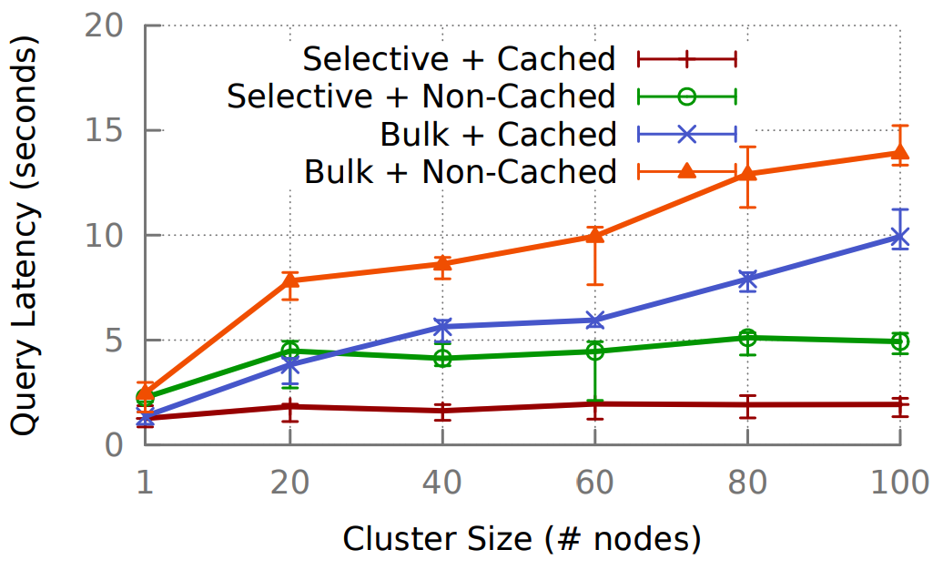
Scalability
Notes:
Lastly, they evaluate the scalibility of BlinkDB as a function of cluster size. They created two sets of queries. The first set is queries that consists of highly selective queries. These queries only operate on a small fraction of input data. Another set is called Bulk, it is the set of queries that operate on large fraction of input data. Cached or non-cached means the required samples are completely cached in memory or not. First, its easy to see that for any of these cases, the aveage query latency is within several seconds. Even if the cluster size becomes 100, the max query latency is only around 15 s. Secondly, we can notice that caching will always reduce the query latency, because green curve is above brown curve and orange curve is above the blue one. Thirdly, increasing the cluster size has little effect on the latency for highly selective quries, because whether the input data is huge or small, these quries only operate on very small number of data. Other than the computation time, the query latency also needs to include the time taken by other operational overhead. But for bulk quries, large cluster size means larger amount of data to be operated on, thus increasing the query latency.

Slide 38
Previous Work on Sampling
STRAT
a single stratified sample
SciBORQ
biased sample based on past query results
no accuracy guarantee
Babcock et al
stratified on a single column, execute query on multiple samples
AQUA
stratified on all combination of columns involved in queries
Olston et al
new sample for each query template

Slide 39
Downside of BlinkDB
Limited Generality
have to assume prior knowledge about the queries
online aggregation (DBO)
Supports only simple queries
joins are not supported (Quickr)

Slide 40
Thanks!
Questions?

